Slide 1

Read Before Starting
Use full screen for best results on desktop, and landscape mode on mobile devices.
You will have 30 seconds
to observe the picture, followed by
4.5 minutes to write the action and story.

Slide 2
WILL STARTS IN 10 SECONDS

Slide 3
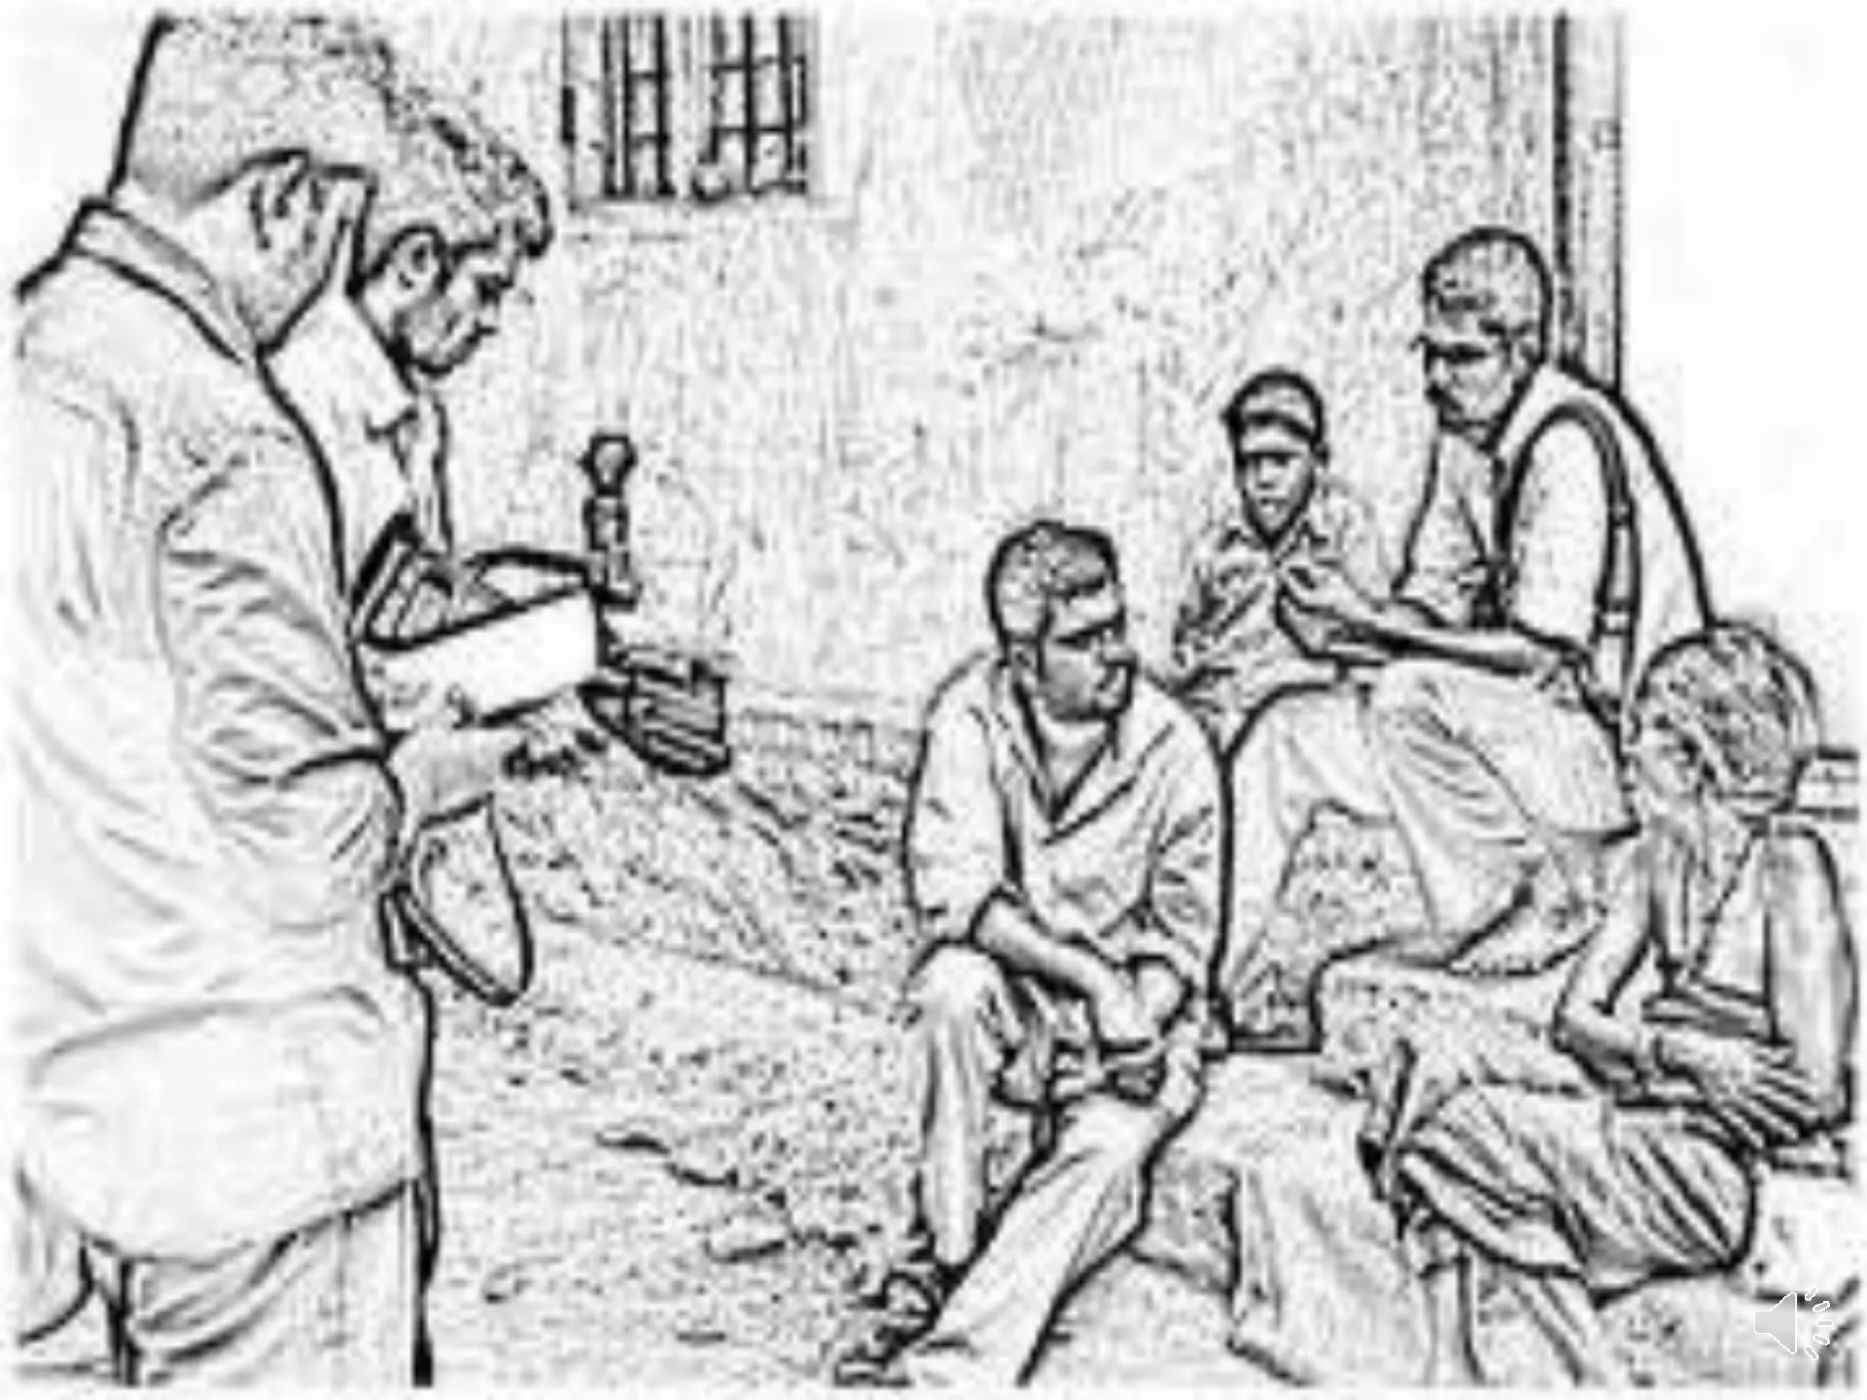

Slide 4
START WRITING

